Slide 1
Decision Making: Decision Tree & State Machines Session 07
Course : COMP6228 – Artificial Intelligence
Effective Period : February 2018

Slide 2
Learning Objective
After completing this session, students are expected to be able to:
LO 2 : Explain concepts of AI Techniques in Games

Slide 3
Content
Overview of Decision Making
Decision Trees
Random Decision Trees
State Machines
Hard-Coded FSM
Hierarchical State Machines
Combining Decision Trees and State Machine

Slide 4
Overview of Decision Making
Behaviour
Decision Trees
States Machines
Behaviour Trees
Fuzzy Logic
Machine Learning

Slide 5
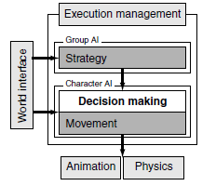
Overview of Decision Making
The AI model

Slide 6
Overview of Decision Making
Their own Health, HP, MP, Skills
Goal, Desire, Emotions, Personality
Update to their own Emotions,
Goal, Desire, Health, HP, MP, Skills
Position of items, Positions of obstacles,
Position of other NPCs, World layout,
Emotions of other NPCs.
Update to position of items,
Ownership of items, Other NPC’s
Emotions.

Slide 7
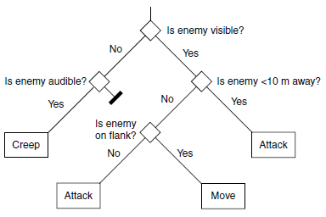
Decision Trees
Decision trees are fast, easily implemented, and simple to understand. They are the simplest decision making technique that we’ll look at, although extensions to the basic algorithm can make them quite sophisticated. They are used extensively to control characters and for other in-game decision making, such as animation control.

Slide 8
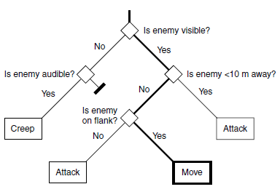
Decision Trees
The path taken by the algorithm is highlighted, showing the arrival at a single action, which may then be executed by the character.
The decision tree with a decision made

Slide 9
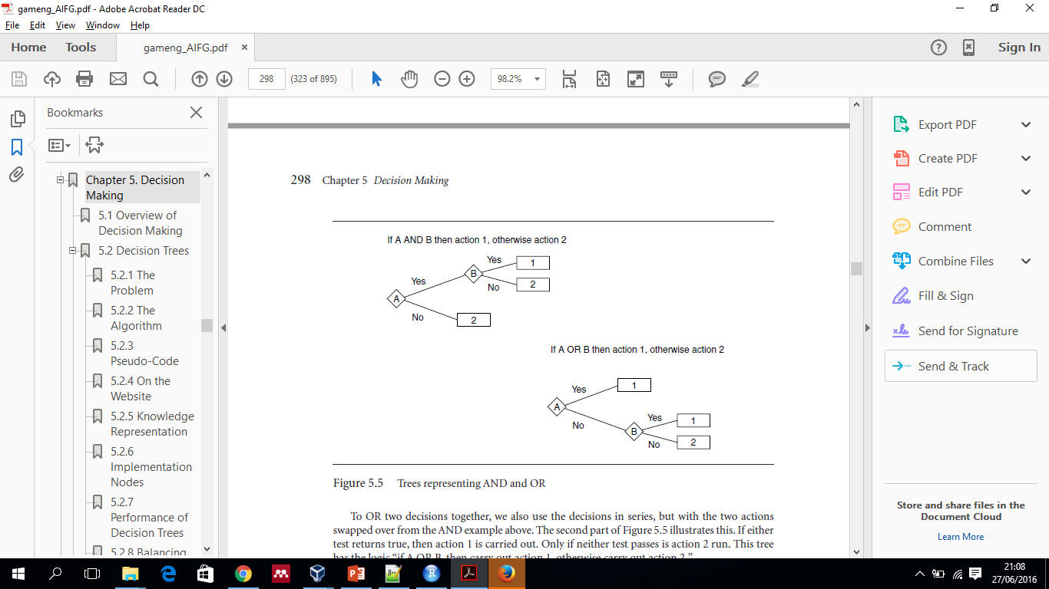
Decision Trees
Combinations of Decisions
The decision tree is efficient because the decisions are typically very simple. Each decision makes only one test. When Boolean combinations of tests are required, the tree structure represents this.
Trees representing AND and OR

Slide 10
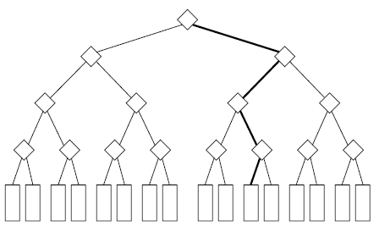
Decision Trees
Branching
The decision tree is efficient because the decisions are typically very simple. Each decision makes only one test. When Boolean combinations of tests are required, the tree structure represents this.
Wide decision tree with decision

Slide 11
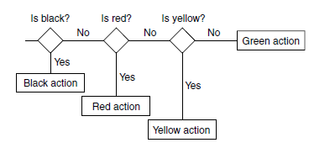
Decision Trees
Branching
Imagine having a guard character in a military facility. The guard needs to make a decision based on the current alert status of the base. This alert status might be one of a set of states: “green,” “yellow,” “red,” or “black,” for example.
Deep binary decision tree

Slide 12
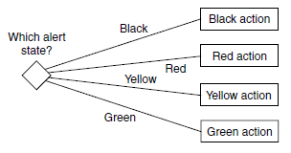
Decision Trees
Branching
We could allow our decision tree to have several branches at each decision point. With four branches, the same decision tree now looks like Figure below.
Flat decision tree with four branches

Slide 13
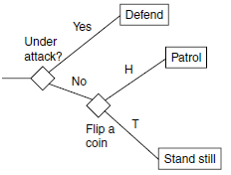
Random Decision Trees
Often, we don’t want the choice of behavior to be completely predictable. Some element of random behavior choice adds unpredictability, interest, and variation.
It is simple to add a decision into the decision tree that has a random element. We could generate a random number, for example, and choose a branch based on its value.
Because decision trees are intended to run frequently, reacting to the immediate state of the world, random decisions cause problems.
Random tree

Slide 14
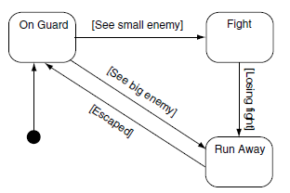
State Machines
State machines are the technique most often used for this kind of decision making and, along with scripting, make up the vast majority of decision making systems used in current games.
A simple state machine
States are connected together by transitions. Each transition leads from one state to another, the target state, and each has a set of associated conditions.

Slide 15
State Machines
Finite State Machines
In game AI any state machine with this kind of structure is usually called a finite state machine (FSM). This and the following sections will cover a range of increasingly powerful state machine implementations, all of which are often referred to as FSMs.
The Game FSM
The basic state machine structure is very general and admits any number of implementations. We have seen tens of different ways to implement a game FSM, and it is rare to find any two developers using exactly the same technique. That makes it difficult to put forward a single algorithm as being the “state machine” algorithm.

Slide 16
Hard-Coded FSM
A few years back, almost all state machines were hard coded.
The rules for transitions and the execution of actions were part of the game code.
It has become less common as level designers get more control over building the state machine logic, but it is still an important approach.

Slide 17
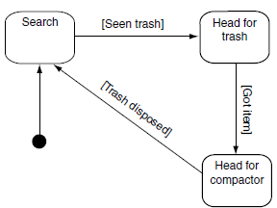
Hierarchical State Machines
On its own, one state machine is a powerful tool, but it can be difficult to express some behaviors. One common source of difficulty is “alarm behaviors.”
Rather than combining all the logic into a single state machine,we can separate it into several. Each alarm mechanism has its own state machine, along with the original behavior. They are arranged in a hierarchy, so the next state machine down is only considered when the higher level state machine is not responding to its alarm.
The basic cleaning robot state machine

Slide 18
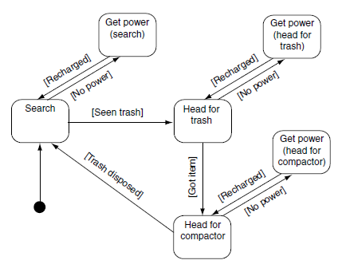
Hierarchical State Machines
An alarm mechanism in a standard state machine

Slide 19
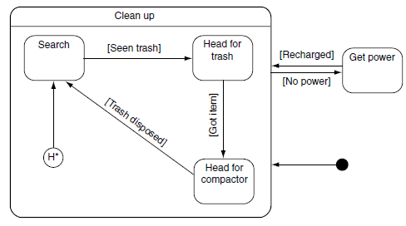
Hierarchical State Machines
A hierarchical state machine for the robot

Slide 20
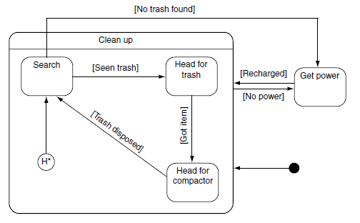
Hierarchical State Machines
A hierarchical state machine with a cross-hierarchy transition

Slide 21
Combining Decision Trees and State Machines
The implementation of transitions bears more than a passing resemblance to the implementation of decision trees.
This is no coincidence, but we can take it even further.
Decision trees are an efficient way of matching a series of conditions, and this has application in state machines for matching transitions.
We can combine the two approaches by replacing transitions from a state with a decision tree. The leaves of the tree, rather than being actions as before, are transitions to new states.

Slide 22
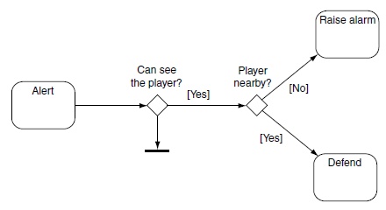
Hierarchical State Machines
The diamond symbol is also part of the UML state chart diagram format, representing a decision. In UML there is no differentiation between decisions and transitions, and the decisions themselves are usually not labelled.
State machine with decision tree transitions

Slide 23
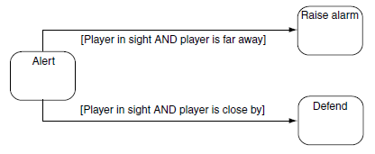
Hierarchical State Machines
To implement the same state machine without the decision nodes, the state machine in Figure below would be required.
State machine without decision tree transitions

Slide 24
References
Ian Millington. 2009. Artificial intelligence for games. Morgan Kaufmann Publishers. Burlington. ISBN:9780123747310
Decision Trees (brief) and Finite State Machines, http://web.cs.du.edu/~sturtevant/ai-s11/Lecture03.pdf

